Slide 1
2. Data Mining Process

Slide 2
CRISP DM process
Business
Understanding
Data Understanding
Data Preparation
Data
Deployment
Modeling
Evaluation
CRISP DM - Cross Industry Standard Process for Data Mining

Slide 3
DS Process
Business
Understanding
Data Understanding
1. Prior Knowledge
Prepare Data
2. Preparation
Training Data
Building Model using Algorithms
3. Modeling
Test Data
Applying Model and performance evaluation
Deployment
4. Application
Knowledge and Actions
5. Knowledge
Notes:
Framework we will be using throughout this training
Central lynchpin in the entire framework is: Algorithms
…let’s double click on Algos

Slide 4
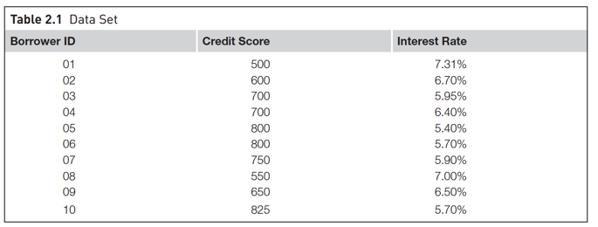
Prior Knowledge
Gaining information on:
Objective of the problem
Subject area of the problem
Data

Slide 5
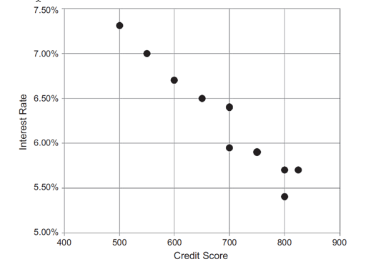
2. Data Preparation
Data Exploration
Data quality
Handling missing values
Data type conversion
Transformation
Outliers
Feature selection
Sampling

Slide 6
3. Modeling
Training Data
Build model
Test Data
Evaluation
Final Model

Slide 7
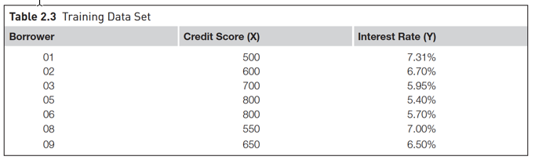
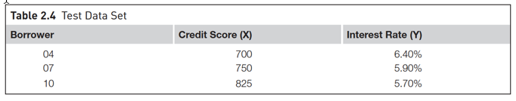
3. Modeling
Spliting training and test data sets

Slide 8
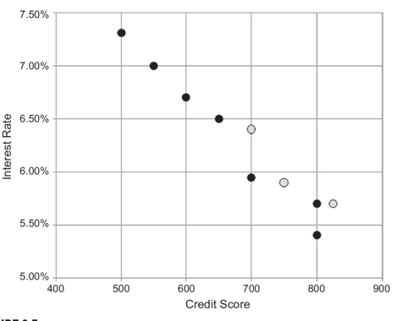
3. Modeling
Spliting training and test data sets
Training Data
Test Data

Slide 9
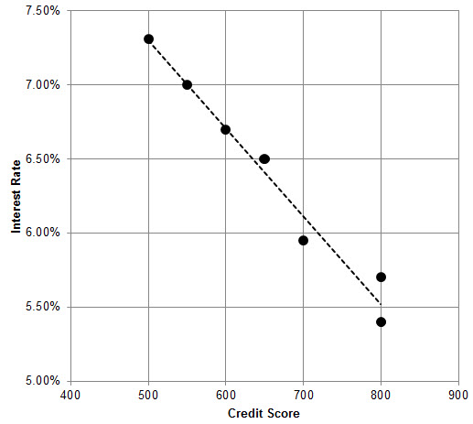

3. Modeling

Slide 10
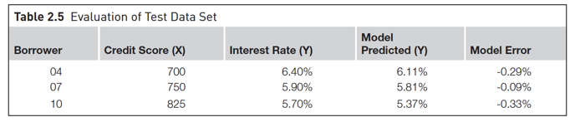
3. Modeling
Evaluation of test dataset

Slide 11
3. Application
Product readiness
Technical integration
Model response time
Remodeling
Assimilation

Slide 12
5. Knowledge
Posterior knowledge
Kotu, V., & Deshpande, B. (2014). Predictive analytics and data mining: concepts and practice with rapidminer. Morgan Kaufmann.

